Slide 1

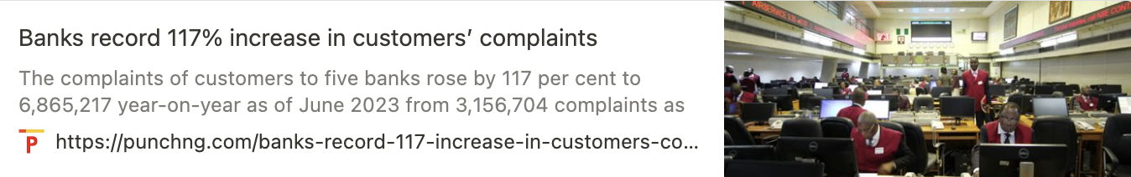


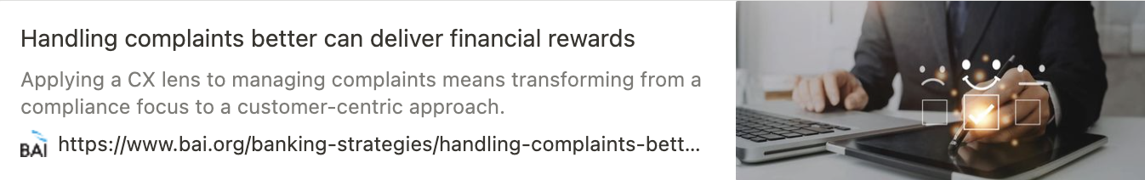
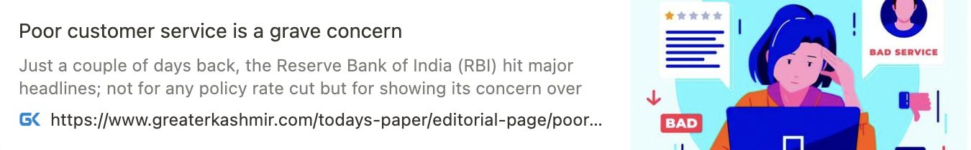
“ Analyzing Financial Complaints in the USA ”
<Team & Roles>
<Project Background>
<Project Goal>
Corporate Perspective
Identify complaint-prone areas through Text Quantification, TF-IDF, Topic Modeling, and Sentiment Analysis to improve the bank's services and assess complaint severity.
Automate complaint resolution using SVM classification.
Government Perspective
Analyze data by grouping it on a state-by-state basis using TF-IDF, Topic Modeling, and Sentiment Analysis to identify key financial issues and sentiments.
Provide policy insights with reports, and visualizing high-frequency words or services for each state.
“The complaints are unverified and often mislabeled and financial institutions have no effective opportunity to respond with the other side of the story,” said Nessa Feddis, a senior vice president at the American Bankers Association.
TEAM 1
21800272 박상범
Data Pre-processing
21800697 조은성
Data Background Information
22000282 박예은
Data Analyzing
Corporate Perspective
U.S. financial companies face daily challenges in addressing a high volume of customer complaints due to limited resources.
Government Perspective
Customized state-specific financial policies are needed, but government requires information on citizen preferences and acknowledges regional policy variations.

Slide 2


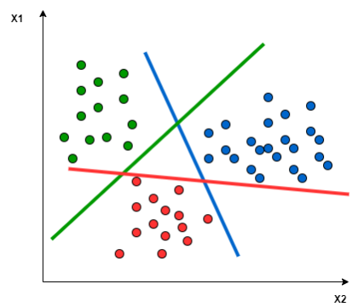
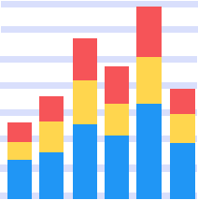
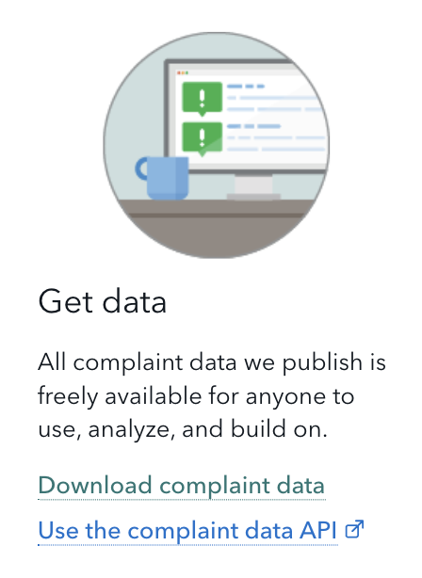
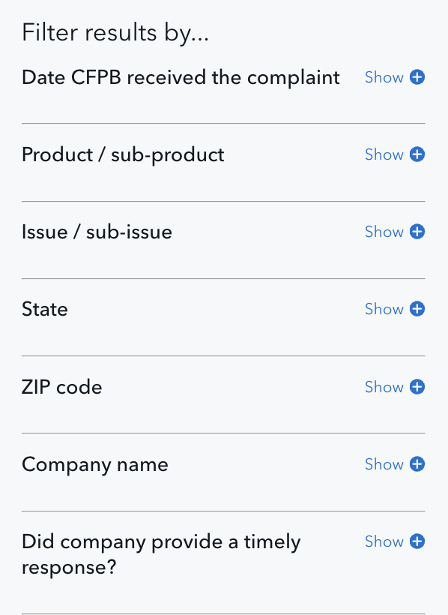
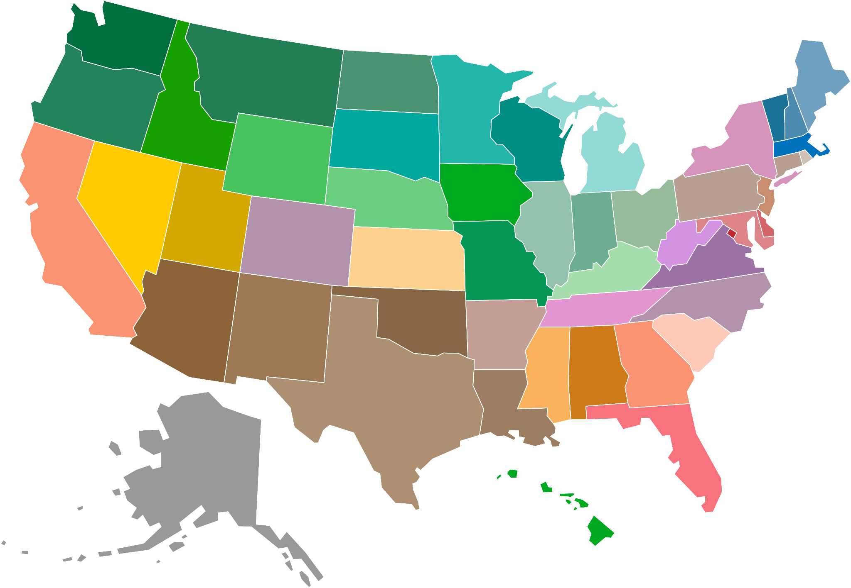

“ Analyzing Financial Complaints in the USA ”
<Data Plan>
<Analysis Plan>
<Expected Results>
Data Collection
Data Collection
Data Pre-processing
R - dplyr, stringr, textstem, etc,.
Data Analyzing
R - stringr, RWeka, tm, etc,.
Classification
Python - SVM
Data Management
Automated complaint handling boosts consumer trust and loyalty.
Enhanced bank reliability prevents consumer withdrawals and decreases bankruptcy risk.
Weekly financial complaint analysis supports policy updates.
Visualization
Mapping, Bar Graph, etc,.

